Slide 1
Case-Study Group 13
Mihai Glodici
Jorn Kosterman
Soufiane El Atmani

Slide 2

Agenda
Idea
Our network
Progress since last time
Possible Implementations
Challenges
Demo
Locust
MDP
Personal reflection

Slide 3

idea
Website for students and teachers
Uploading lectures and demos
Able to convert videos
Multi-cloud
Automation with Terraform/CloudFormation
Serverless; infrastructure as code

Slide 4
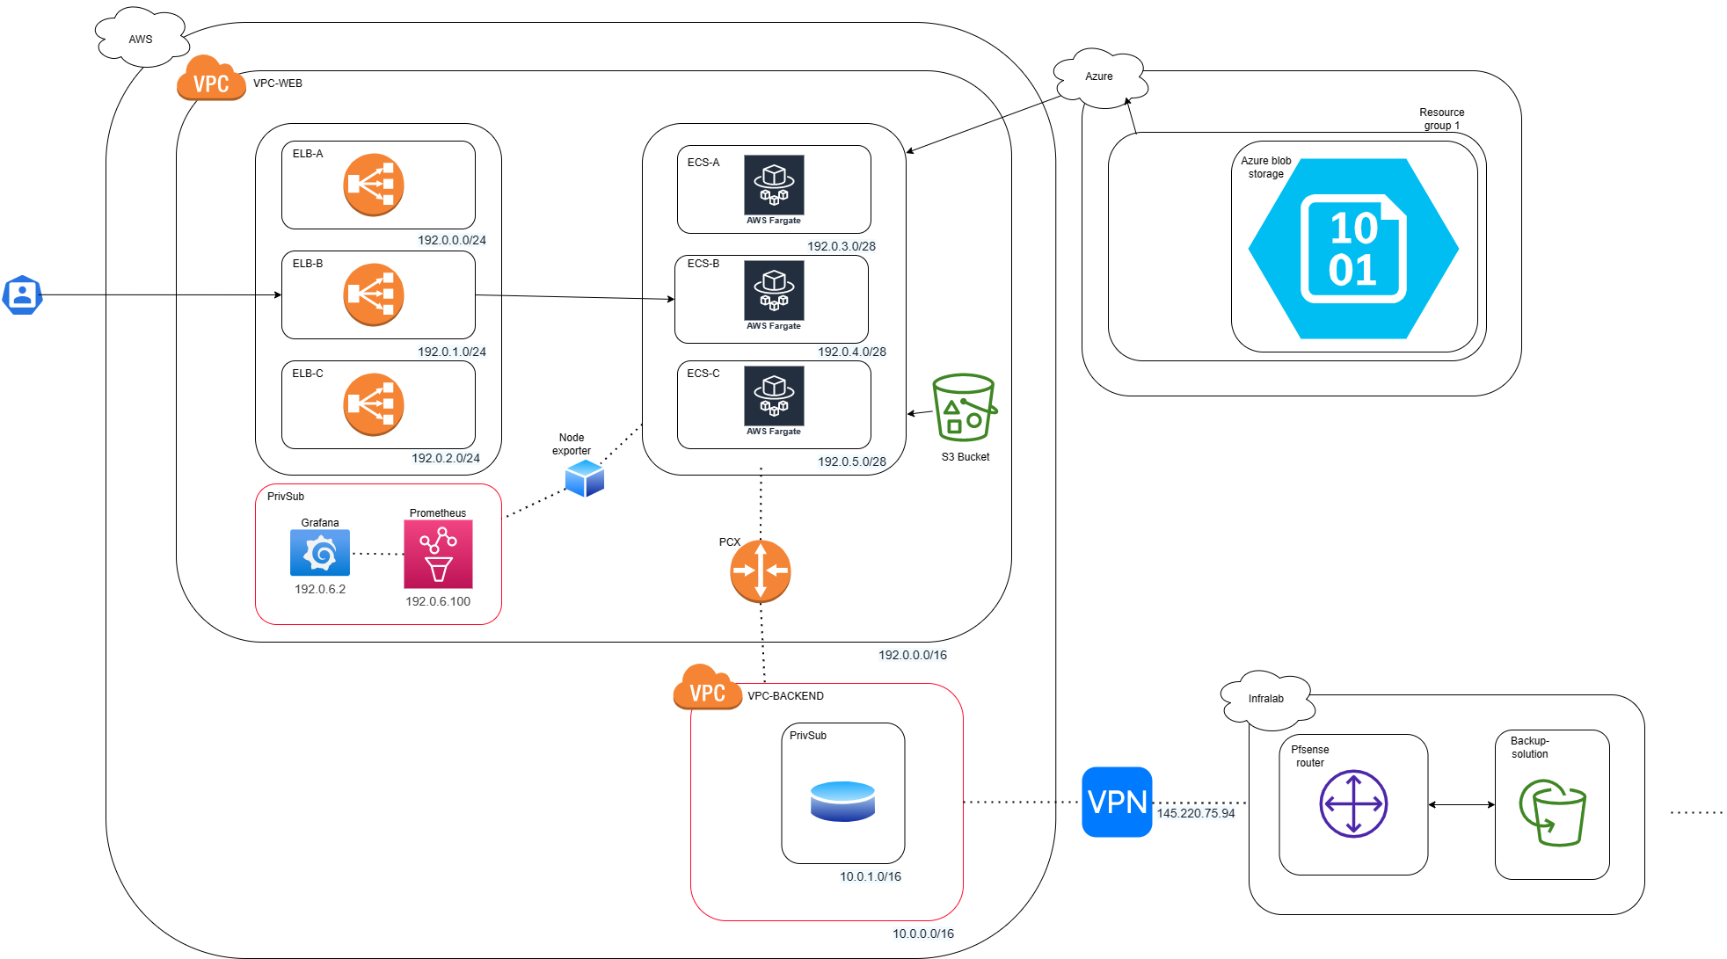
Our network

Slide 5


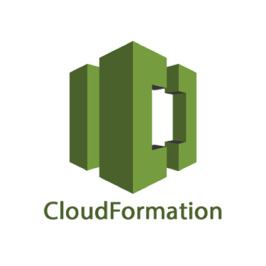
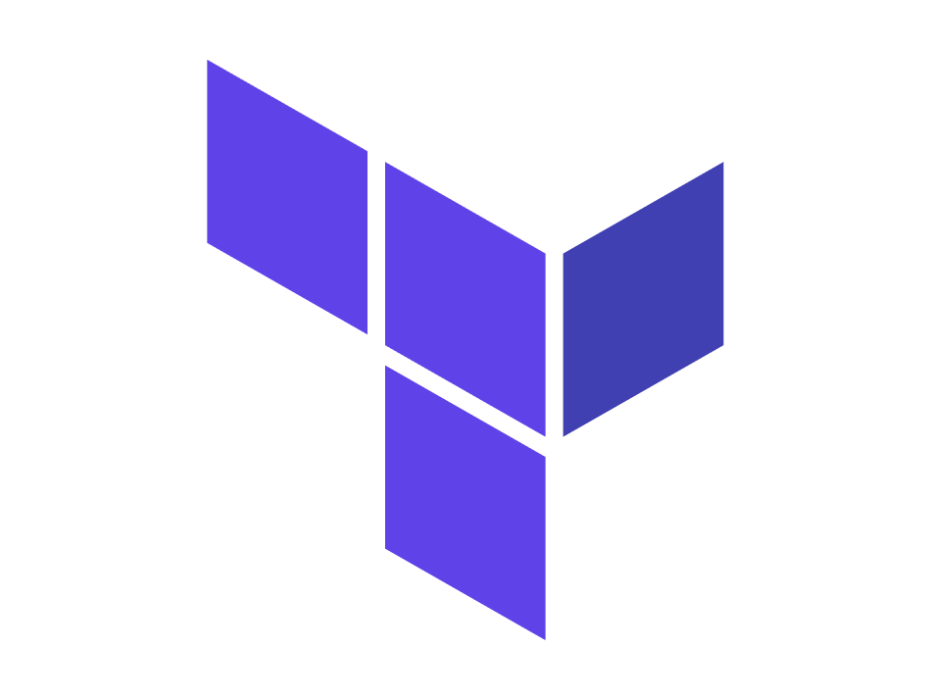
Progress since last time
Last version of terraform script (Database,VPN,PCX)
CloudFormation stacks
Prometheus and CloudWatch monitoring solution
Grafana dashboards
Https LoadBalancer

Slide 6
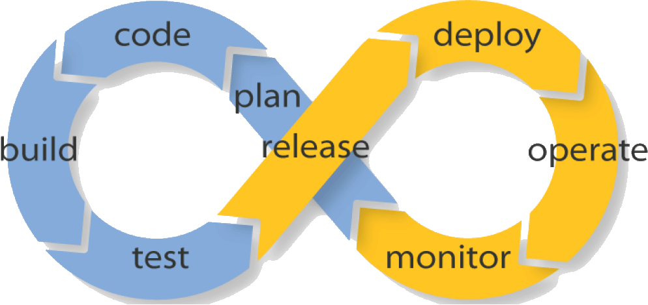
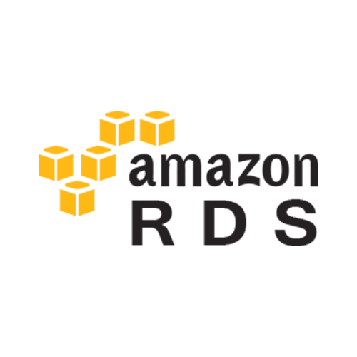
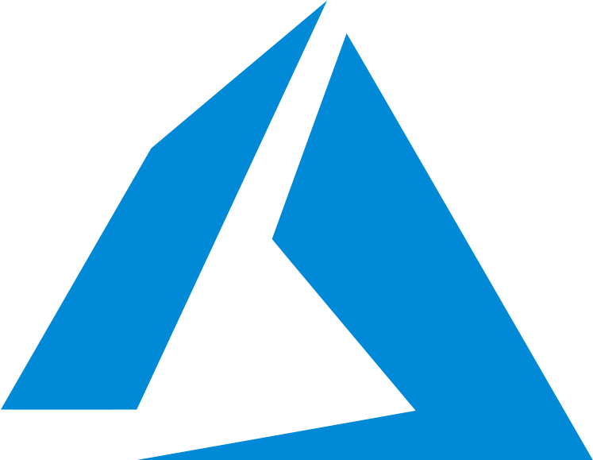
Possible implementations
CI/CD pipeline
Automating Azure infrastructure
RDS Backup

Slide 7
Challenges
Node exporter in Fargate instances (Docker edit)
Limiting Prometheus scrape autoscale target IPs (/28mask)
Locust hosting and running
Security Groups/Network ACLs

Slide 8
Demo
Terraform/CloudFormation script
Multicloud storage
Monitoring Dashboards

Slide 9
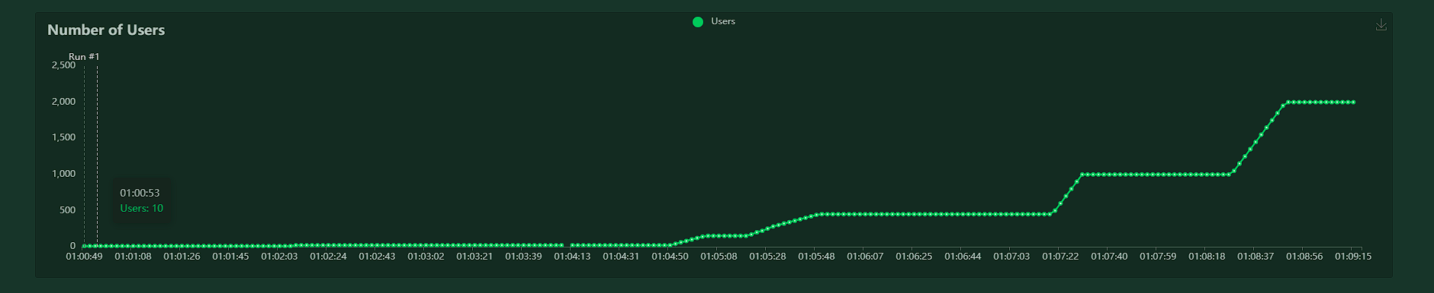
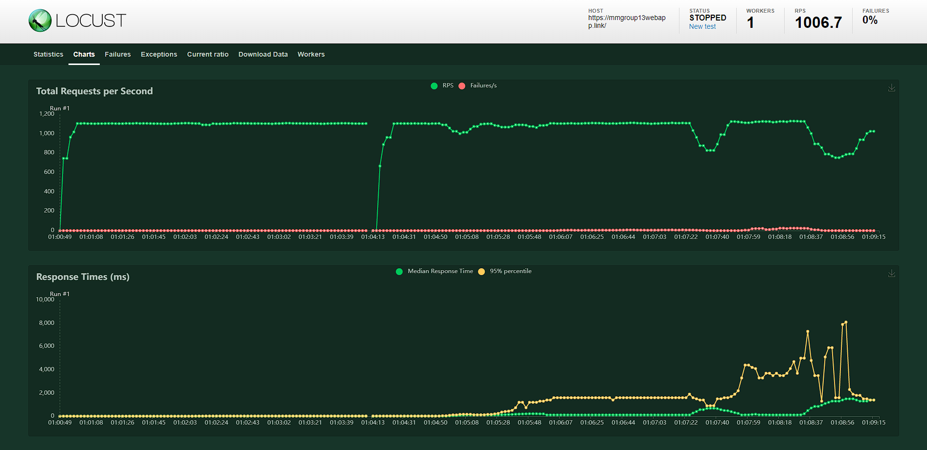
Locust test results

Slide 10

MDP
USPC
Stakeholder did not have an existing infrastructure for secure data storage
So we designed it for them!

Slide 11
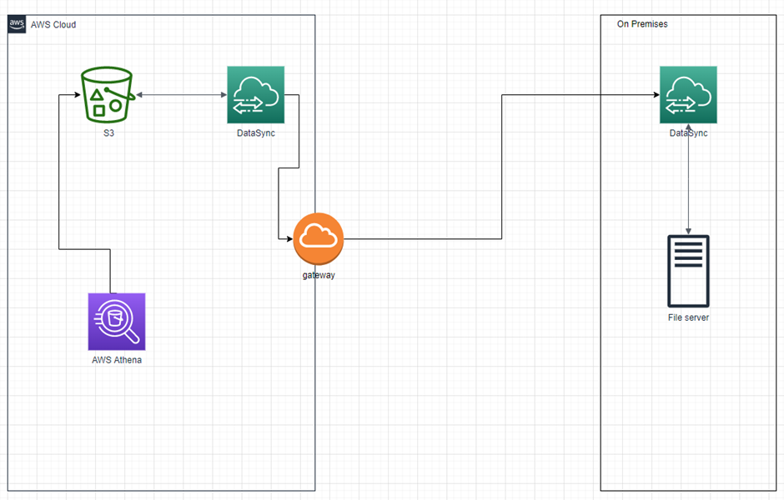
MDP
USPC
Completed:
Hybrid data storage solution
Athena Sql querries
DataSync for syncronizing storage
Suggested addition:
Webapp file transfer

Slide 12
Personal reflection
Mihai
Automation experience, VPC networking and monitoring
Teamwork collaboration and planning
Limited MDP requirements/ unprofessionalism
Jorn
Much progress at once
Rushed in the end
Delivered a good project
Soufiane
Good experience with automation
Some struggles with implementation and testing

Slide 13

The End
Questions?

